Slide 1



DATA SCIENCE PROJECT ON
PROFIT PREDICTION OF 50 STARTUP COMPANIES
Presented by: Amisha Naik

Slide 2

Table of Contents
1. Introduction
2. Existing Method
3. Proposed method
4. Architecture
5. Implementation
6. Conclusion

Slide 3


Introduction
This Profit Prediction Model aims at predicting the profit of the start-up based on the values of Administration Spend, R&D Spend, Marketing Spend and Location using different machine learning algorithms.
The dataset consists of the data of 50 start-ups. The dataset consists of the values of four parameters which are R&D Spend, Marketing Spend, Administration Spend in which the start-up is located.
The selected dataset is then fed for further processing. Data Pre processing including data cleaning and outlier removal is Profit Prediction Model using Machine learning Algorithms done.
The pre-processed data is then trained and tested. Out of the complete dataset, 30% of the dataset is used for testing purpose and the remaining 70% precent of the dataset is used for training.

Slide 4
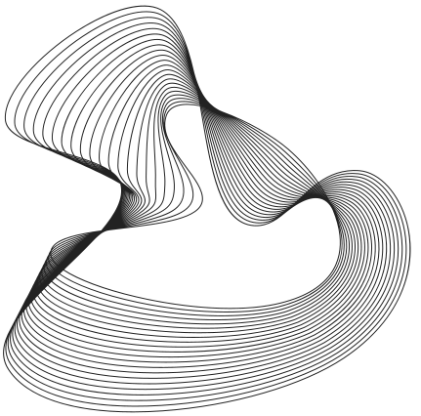
Existing Method
A startup profit prediction model has been developed using Multiple Linear Regression1. The model can be used to determine whether a venture capitalist should invest in a particular startup or not. While this approach holds promise, its essential to acknowledge some existing methodologies used in this domain
some disadvantages are- limited scope, overfitting, limited accuracy

Slide 5
PROPOSED METHODOLOGY
Proposed Methodology consists of the following steps: -
Data Gathering: - This is the first step involved in the process of making profit prediction. It consists of the data values of 50 start-up companies.
Data Pre-processing: - Data Pre-processing is done after loading the dataset. This step involves optimizing the dataset by removing the outliers and unnecessary details from the dataset to provide most accurate results.
Selecting a Model: - Machine learning algorithms implemented in this model to predict the profit.
Prediction of Profit: - One of the above-mentioned models can be used to make prediction of profit by providing the values of the required variables. These parameters include money spent for different causes such as R&D, Marketing and Administration purpose.

Slide 6
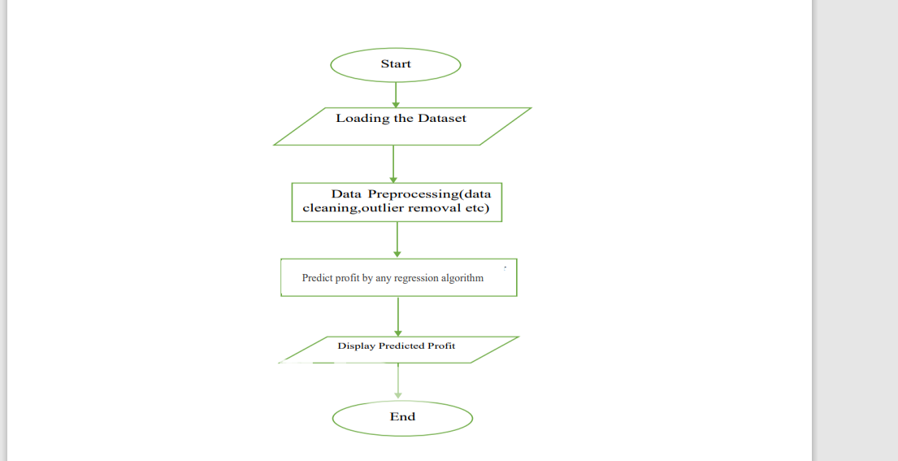
SYSTEM ARCHITECTURE

Slide 7
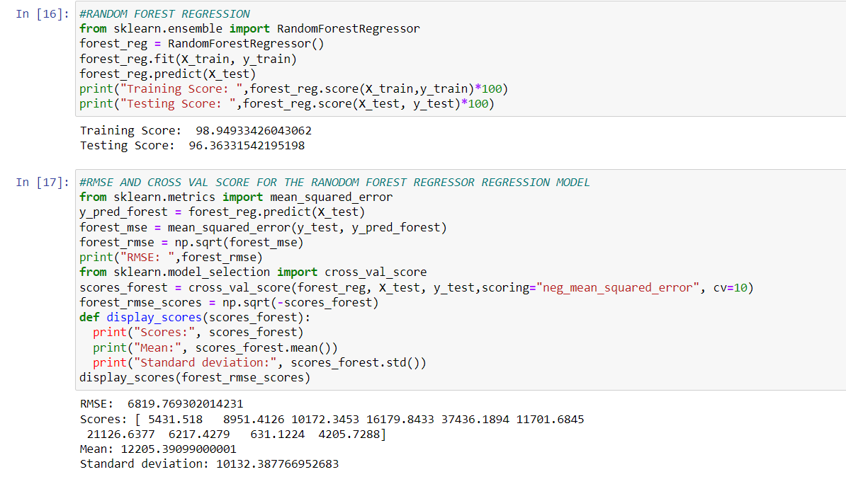
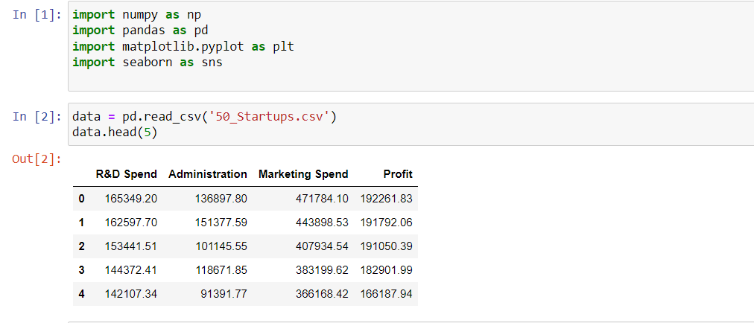
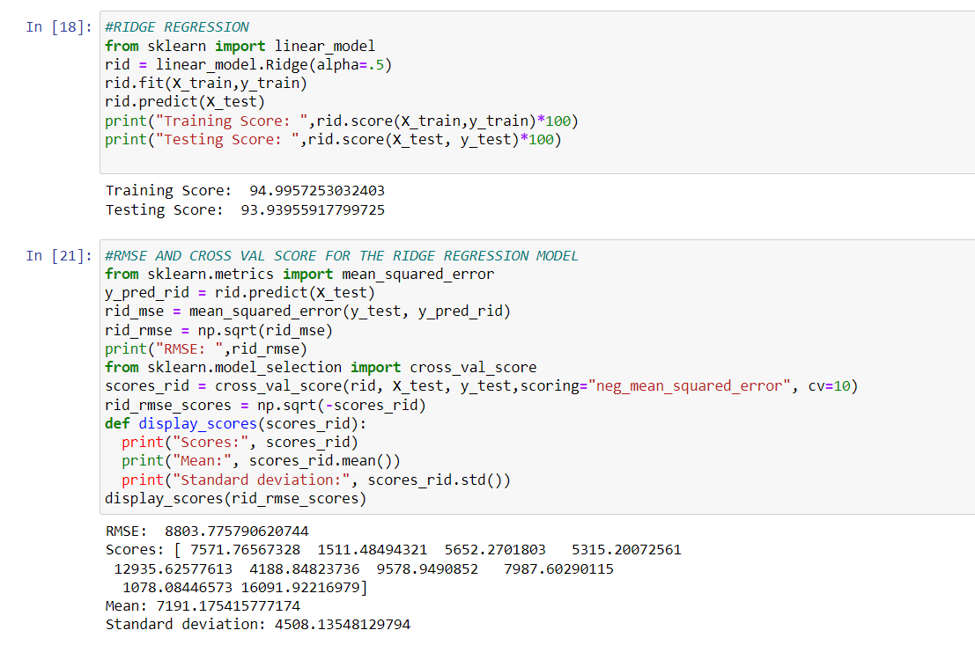
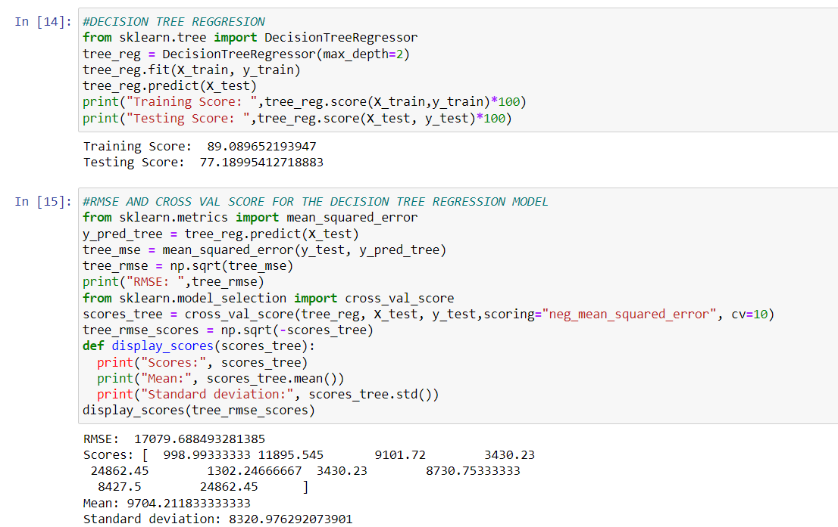
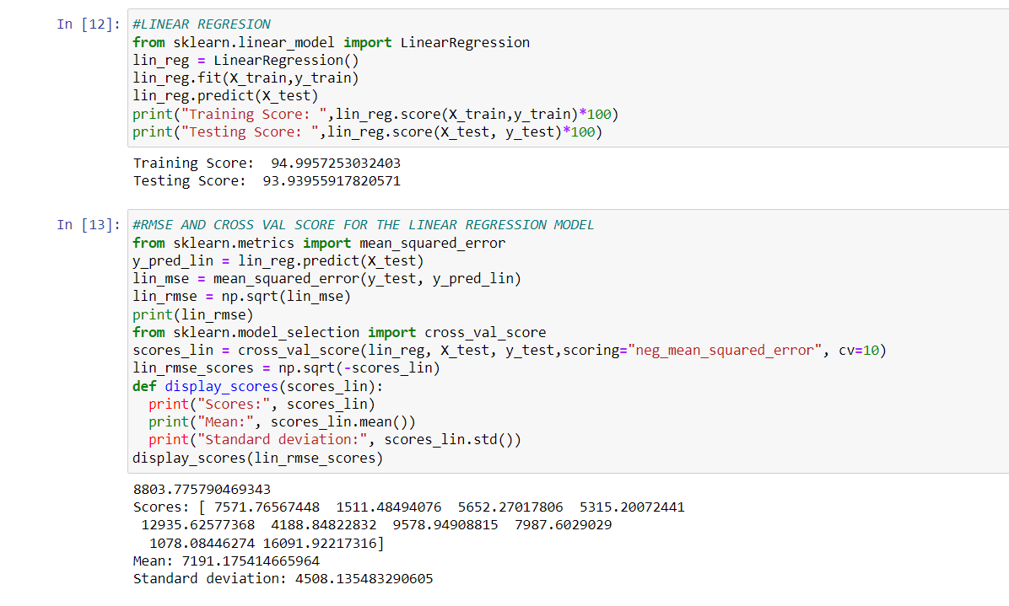
IMPLEMENTATION

Slide 8

CONCLUSION
The prediction of profit across 50 startups is found using four different regression model. The four models are Linear regression, Decision Tree regression and Random forest. It is observed that Random Forest Regression works well as compared to rest regression algorithm for the prediction of the value of profit. Therefore, the best model is the Random forest as the score of the model is around 96% which is the best compared to the rest.

Slide 9

Thank You
Gerente General

